Slide 1
Building a Job Placement Prediction Model using Machine Learning
Designed By: Ryan Baptista
Guidance By: Miss Urooj Khan
*You can make a copy of the slides. Do not change the template branding.

Slide 2
What is Machine Learning?
Machine Learning is a branch of artificial intelligence which studies the hidden
Patterns of datasets used to make predictions on new similar type of data.
Traditional machine learning combines data with statistical tools to predict an
Output that can be used to make actionable insights.
Machine Learning is used in many different applications like speech-recognition
To natural language processing,recommendation systems,fraud detection,portfolio
Organisation,automated task and so on.Machine learning is also used to power
Autonomous vehicles,drones and robots,making them more intelligent and adaptable
to changing environments.

Slide 3
Preparation of Dataset
.
a)Found Dataset from https://www.kaggle.com/datasets/tejashvi14/engineering-placements-prediction
b)Prepared the data to be used by converting necessary columns from string to readable format.

Slide 4
Code
import numpy as np
import streamlit as st
import pandas as pd
import matplotlib.pyplot as plt
from sklearn.ensemble import RandomForestClassifier
from sklearn.preprocessing import StandardScaler
from sklearn.model_selection import train_test_split
from sklearn.metrics import accuracy_score,r2_score
# Load the dataset
@st.cache_data
def load_data():
return pd.read_csv('encoded_dataset.csv')
# Preprocess data
def preprocess_data(data):
# Drop rows with missing values
data.dropna(inplace=True)
# Define features and target variable
X = data.drop(['PlacedOrNot'], axis=1) # Exclude 'name' column
y = data['PlacedOrNot']
# Split the data into training and testing sets
X_train, X_test, y_train, y_test = train_test_split(X, y, test_size=0.2, random_state=42)
# Feature Scaling
scaler = StandardScaler()
X_train_scaled = scaler.fit_transform(X_train)
X_test_scaled = scaler.transform(X_test)
return X_train_scaled, X_test_scaled, y_train, y_test, scaler
# Train the model
@st.cache_data
def train_model(X_train_scaled, X_test_scaled, y_train):
model = RandomForestClassifier(n_estimators=100, random_state=42)
model.fit(X_train_scaled, y_train)
return model
# Main function to run the Streamlit app
def main():
st.title('Job Placement Prediction Model')
# Load data
data = load_data()
# Preprocess data
X_train_scaled, X_test_scaled, y_train, y_test, scaler = preprocess_data(data) # Retrieve scaler
# Lists to store accuracy scores
train_accuracies = []
test_accuracies = []
for _ in range(10): # 10 iterations for example
# Train model
model = train_model(X_train_scaled, X_test_scaled, y_train)
# Evaluate on training data
train_pred = model.predict(X_train_scaled)
train_accuracy = accuracy_score(y_train, train_pred)
train_accuracies.append(train_accuracy)
# Evaluate on testing data
test_pred = model.predict(X_test_scaled)
test_accuracy = accuracy_score(y_test, test_pred)
test_accuracies.append(test_accuracy)
# Plot accuracy scores
fig, ax = plt.subplots(figsize=(10, 6)) # Create a single figure with the desired size
epochs = np.arange(1, 11) # Assuming 10 iterations
ax.plot(epochs, train_accuracies, label='Training Accuracy') # Use ax.plot instead of plt.plot
ax.plot(epochs, test_accuracies, label='Testing Accuracy') # Use ax.plot instead of plt.plot
ax.set_xlabel('Epochs') # Use ax.set_xlabel instead of plt.xlabel
ax.set_ylabel('Accuracy') # Use ax.set_ylabel instead of plt.ylabel
ax.set_title('Accuracy Comparison: Training vs Testing') # Use ax.set_title instead of plt.title
ax.legend() # Use ax.legend instead of plt.legend
st.pyplot(fig) # Pass the figure to st.pyplot
st.sidebar.subheader('User Input')
# Collect user input features
user_input = {}
for feature in data.drop(['PlacedOrNot'], axis=1).columns:
user_input[feature] = st.sidebar.number_input(f'Enter {feature}', min_value=0, max_value=100)
# Make predictions
if st.sidebar.button('Predict'):
user_data = pd.DataFrame([user_input])
scaled_user_data = scaler.transform(user_data)
prediction = model.predict(scaled_user_data)
if prediction[0] == 1:
st.write('Congratulations! The model predicts that you will get placed.')
else:
st.write('Sorry! The model predicts that you will not get placed.')
# Evaluation metrics
y_pred = model.predict(X_test_scaled)
accuracy = accuracy_score(y_test, y_pred)
r2 = r2_score(y_test, y_pred)
st.write(f'Accuracy: {accuracy}')
st.write(f'R2 Score: {r2}')
if __name__ == '__main__':
main()

Slide 5
Implementation
Importing the necessary libraries like streamlit,pandas for data
Manipulation and matplotlib for plotting the data.
Necessary data was loaded from the newly created dataset.
Then we move on to preprocessing the data by using the preprocess_data Function for training the model.It drops rows with missing values and separates features from target variable,splits the data into training and testing sets and applies feature scaling using standard scaler from scikit-learn.
The train model function trains the Random Forest classifier using the data.
After that we evaluate the model performance by using metrics like accuracy,f1 score,mean absolute error,mean squared error and R2 score.
A provision is made for user input for predicting student placement.

Slide 6
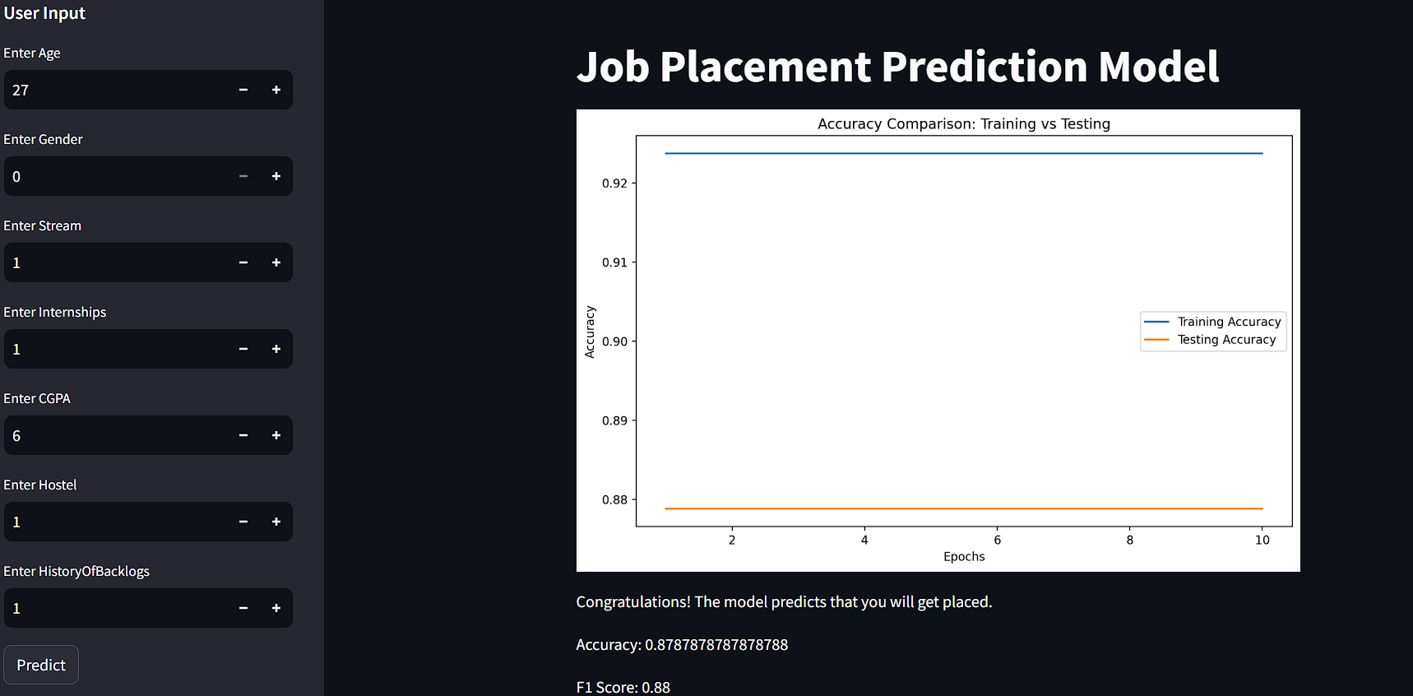
Output

Slide 7
Important Links:-
GitHub Public Repository Link:https://github.com/RoquaSpartan95/FinalProject.git
Streamlit App Link:https://finalproject2.streamlit.app/

Slide 8
Conclusion
Job Placement prediction model was successfully built and
Implemented using Machine Learning.

Slide 9
Thank you

